Slide 1
SIMS-AFM-SEM combination for elemental mapping and 3D reconstruction
Lex Pillatschª, James Whitbyª, Leandro von Werraª, Frederik Oestlund^{b},
Johann Michlerª
ªEmpa, Swiss Federal Laboratories for Materials Science and Technology
^{b}TOFWERK AG, Thun, Switzerland

Slide 2
Overview
Introduction: Multi analysis tool
Principle of secondary ion mass spectrometry
Orthogonal Time-of-Flight mass spectrometer H-ToF
In-situ AFM
AFM-SIMS combination
Applications: VCSEL measurement
Cluster ion software
Outlook

Slide 3
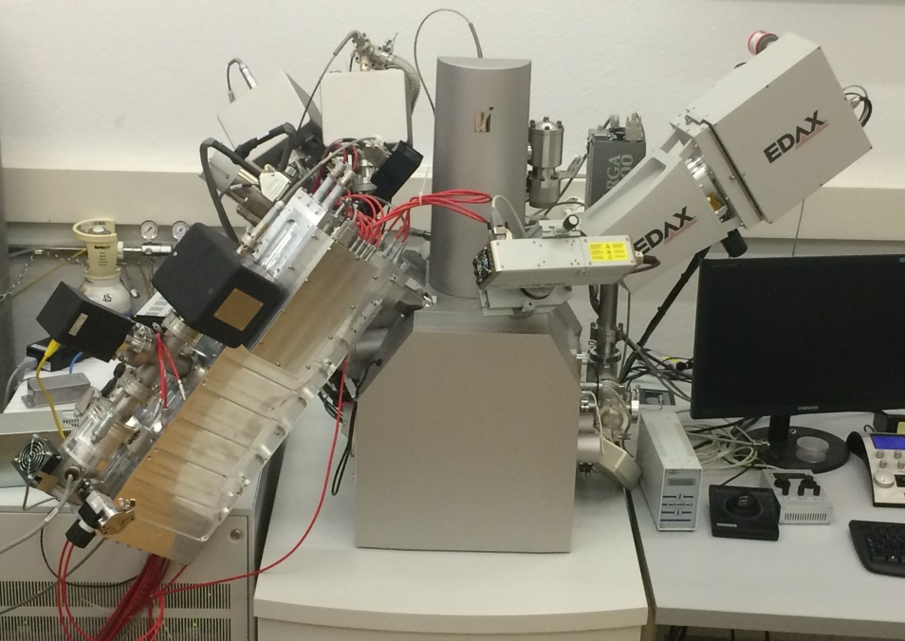
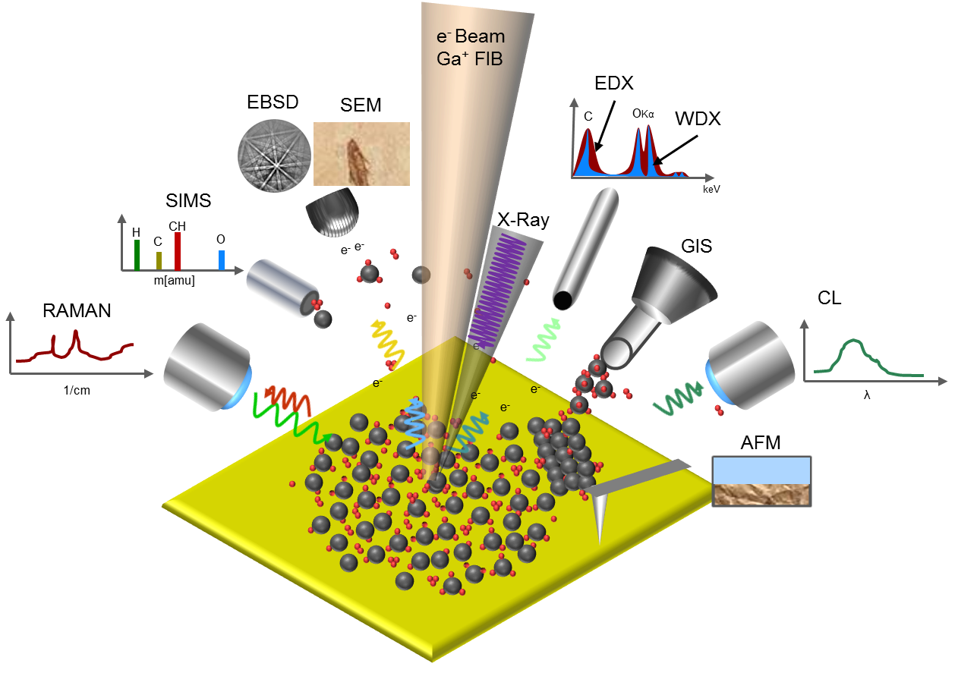
Multi analysis tool:
Different surface analysis techniques combined in one instrument
Detectors are attached on a TESCAN LYRA 3GM FIB-SEM Microscope

Slide 4
Elemental mapping
Detection and location of elements:
SIMS analysis
Detection of the elements according to their m/Q ratio
Localization of the elements with a lateral resolution <50nm
Determination of the sputtered depth is not possible
AFM
Measurement of the sputter induced surface roughness
Determination of the depth of the sputtered crater
SEM
Visualization of the sputtered area
MSM-XIX, 29 March -2 April 2014, Cambridge, UK

Slide 5
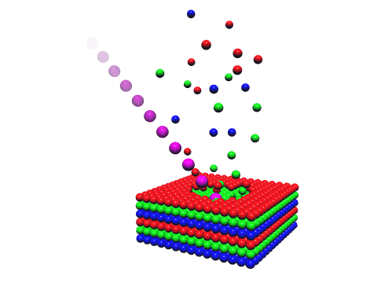
SIMS
Principle of SIMS
H
O
+
Li
Cu
Primary ion beam
m[amu]
e⁻
-
-
Mass spectrometer
-
e⁻
+
-
e⁻
-
e⁻
+
+
Sputtered particles
e⁻
Advantages:
- Detection of all chemical elements (not possible with EDX)
High mass resolving power
Positive and negative ion detection is possible (not simultaneously)
- Elemental mapping with high lateral resolution (<50nm)
- High depth resolution (<10nm)
- Low detection limit (ppm is possible)
Disadvantages:
- Quantification is not possible (Matrix effect)
- Destructive analysis technique
MSM-XIX, 29 March -2 April 2014, Cambridge, UK

Slide 6
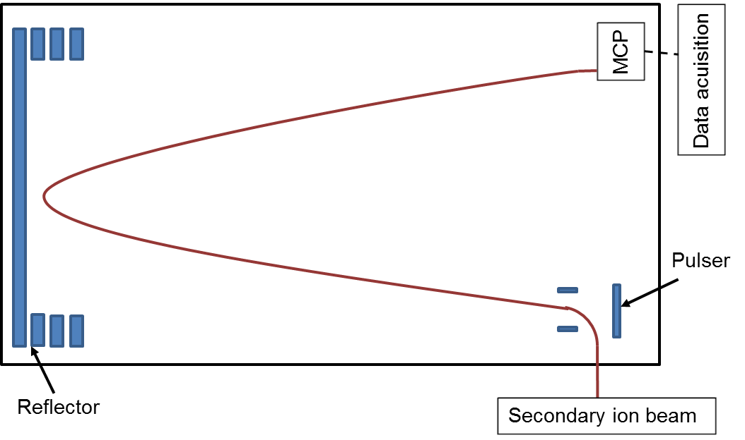
Orthogonal ToF Mass Spectrometer
Secondary ion beam is pulsed
- Continuous sample sputtering
Mass resolving power is maintained also for higher masses
Parallel mass detection
m/Q range 1-4000 Th
MSM-XIX, 29 March -2 April 2014, Cambridge, UK
Notes:
Maybe not for SIMS

Slide 7
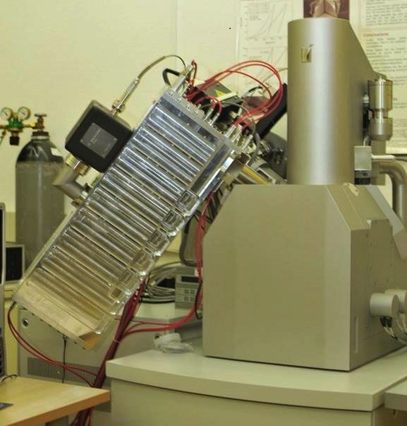
High resolution-ToF
Mass spectrometer on a FIB-SEM instrument
- Primary ion source: Ga-FIB
 | H-ToF
Ion extraction potential | <200 V
Distance to the sample | ~6 mm
Minimum dwell time/pixel | 10 μs
Lateral resolution | <50 nm
Vacuum pressure | 5x10⁻⁷-1x10⁻⁶ mbar
Mass resolving power at FWHM | >3000 Th/Th
Ion flight path | 1.2 m
MSM-XIX, 29 March -2 April 2014, Cambridge, UK
Notes:
EMPA setup

Slide 8
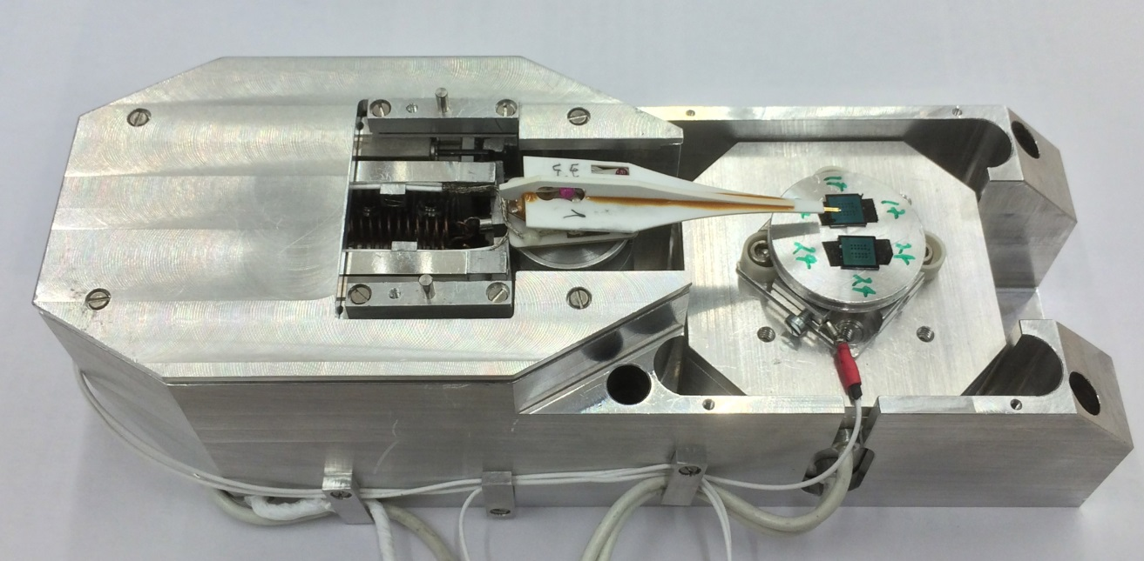
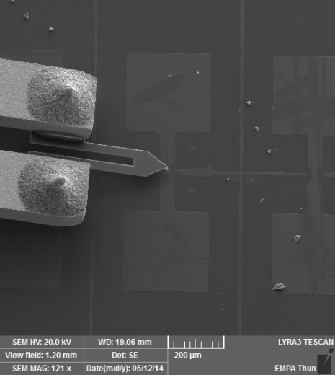
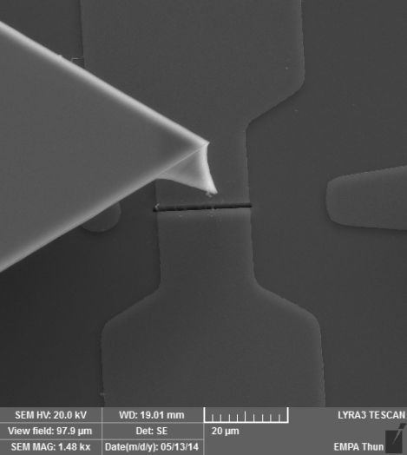
In-Situ AFM
AFM setup to integrate in our FIB-SEM instrument
High Spatial Resolution Time-of-Flight Secondary Ion Mass Spectrometry for the Masses: A Novel Orthogonal ToF FIB-SIMS Instrument with In Situ AFM, Whitby et al (2012) Advances in Materials Science and Engineering 180437 pp 1-13
SEM images of the Akiyama tuning fork AFM TIP
Implementation and characterisation of a quartz tuning fork based probe consisted of discrete resonators for dynamic mode atomic force microscopy, Akiyama et al (2010) Review of Scientific Instruments 81 pp 1-8
MSM-XIX, 29 March -2 April 2014, Cambridge, UK

Slide 9
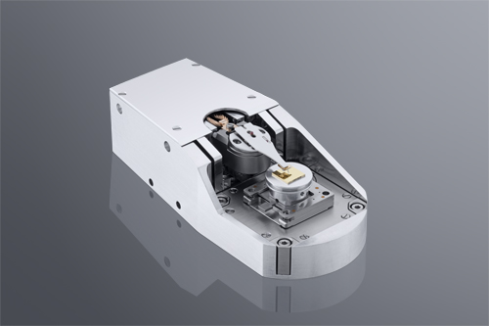
AFM-SIMS specifications
AFM prototype
Curlew AFM
 | Prototype | Curlew SPM
Coarse motion | several mm | ± 5 mm
Radius of the tip apex | 15 nm | 15 nm
Scan area | 10x10 um | up to 50x50 um
Scan speed | 2 s /10 um | 1 s /10 um
Q-factor in vacuum | 4000-5000 | ~4000
MSM-XIX, 29 March -2 April 2014, Cambridge, UK

Slide 10
AFM-SIMS combination
Tip motion and data acquisition controlled by a python script
Tip positioning on the surface
Tip positioning on the surface
Roughness measurement by AFM
Roughness measurement by AFM
Depth information
Depth information
Elemental information by SIMS
Elemental information by SIMS
MSM-XIX, 29 March -2 April 2014, Cambridge, UK

Slide 11
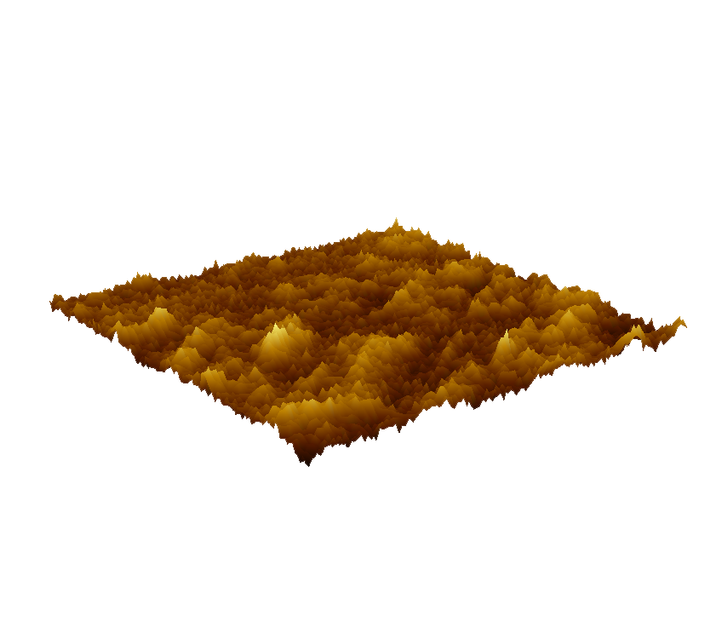
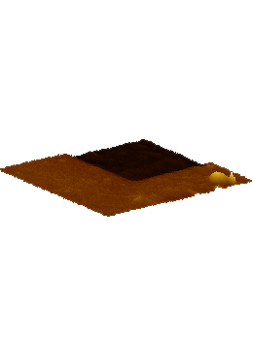
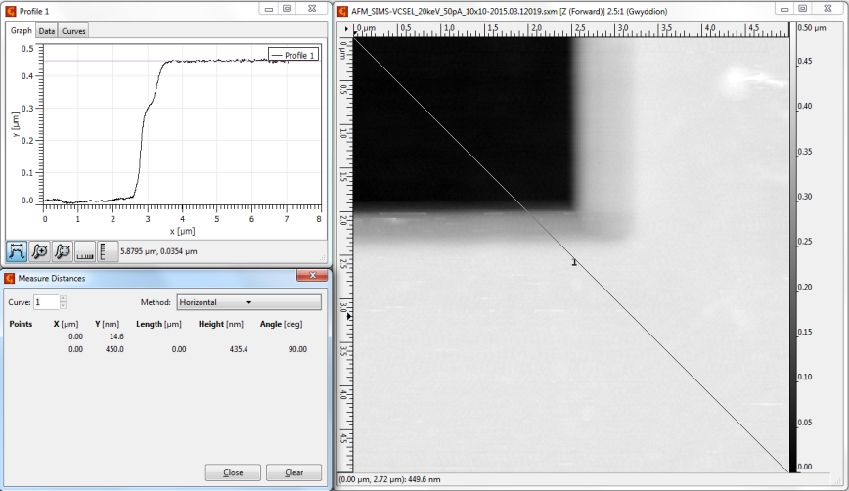
AFM roughness and depth determination
SIMS profile
AFM roughness measurement
AFM depth calibration
MSM-XIX, 29 March -2 April 2014, Cambridge, UK

Slide 12
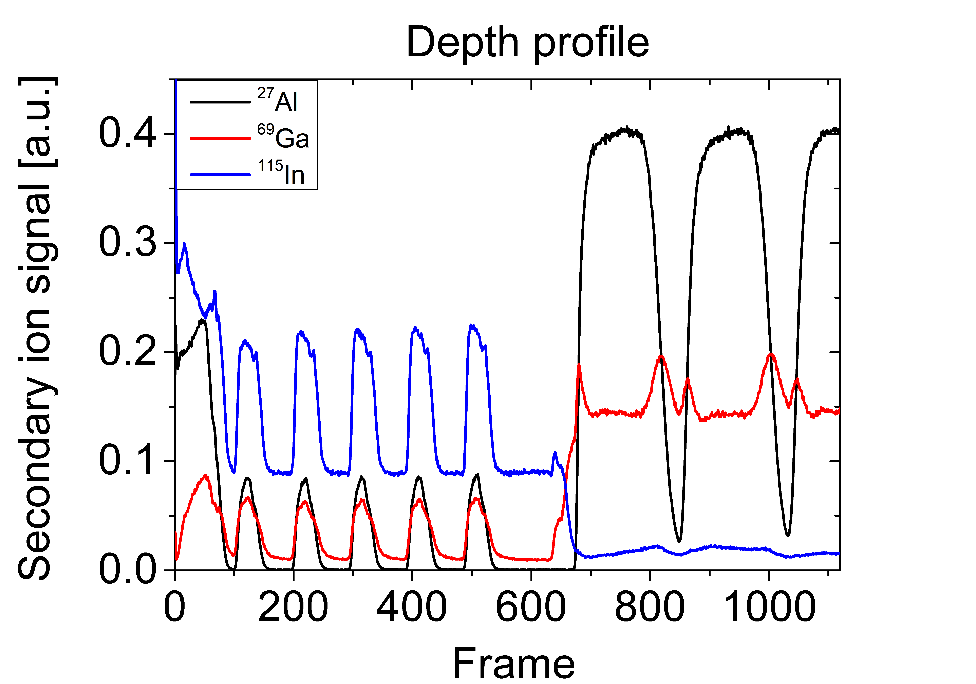
AFM-SIMS on Vertical Cavity Surface Emitting Laser (VCSEL)
InP (10 nm)
AlInAs (80 nm)
InP (10 nm)
Al_{x}Ga_{1-x}In_{y}As_{1-y} (44 nm)
InP (155 nm)
5x
InP (280 nm)
GaAs (100 nm)
Al_{0.9}Ga_{0.1}As (100 nm)
35x
GaAs substrate
MSM-XIX, 29 March -2 April 2014, Cambridge, UK

Slide 13
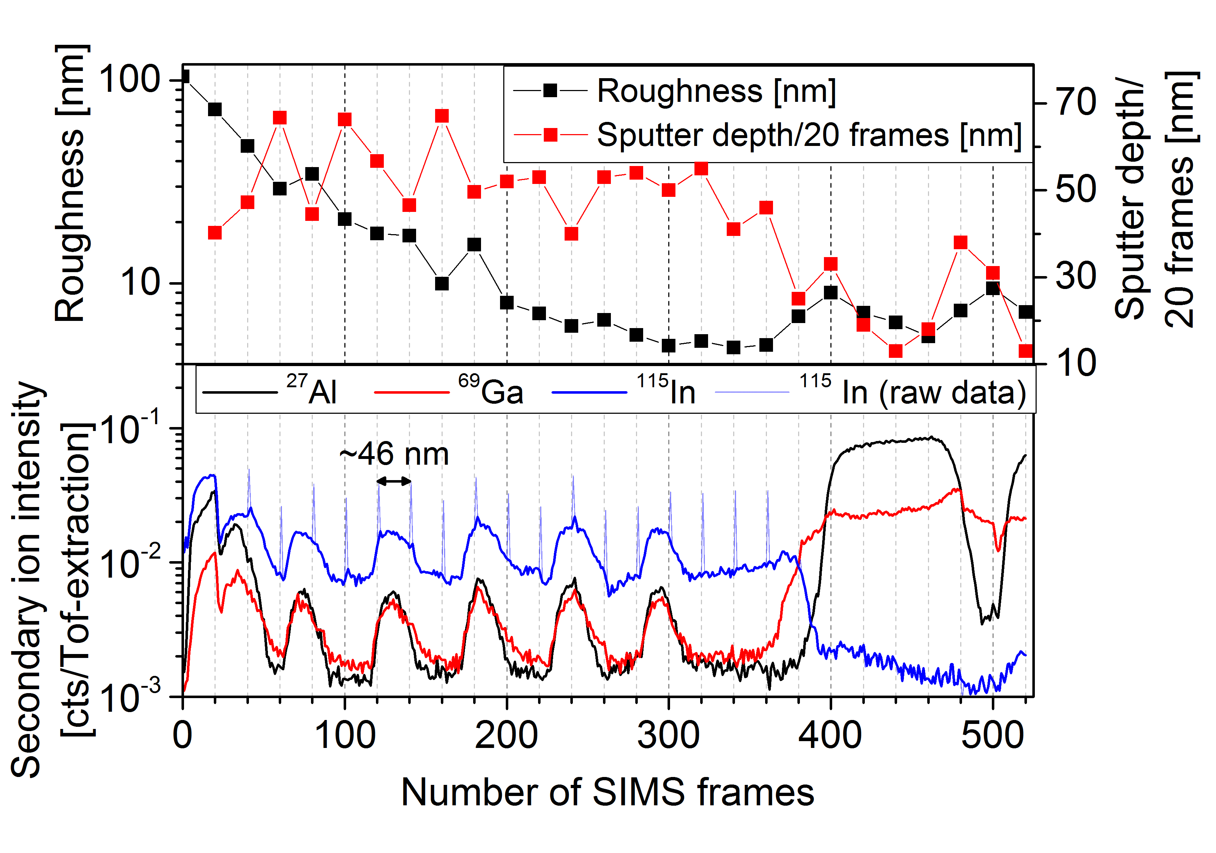
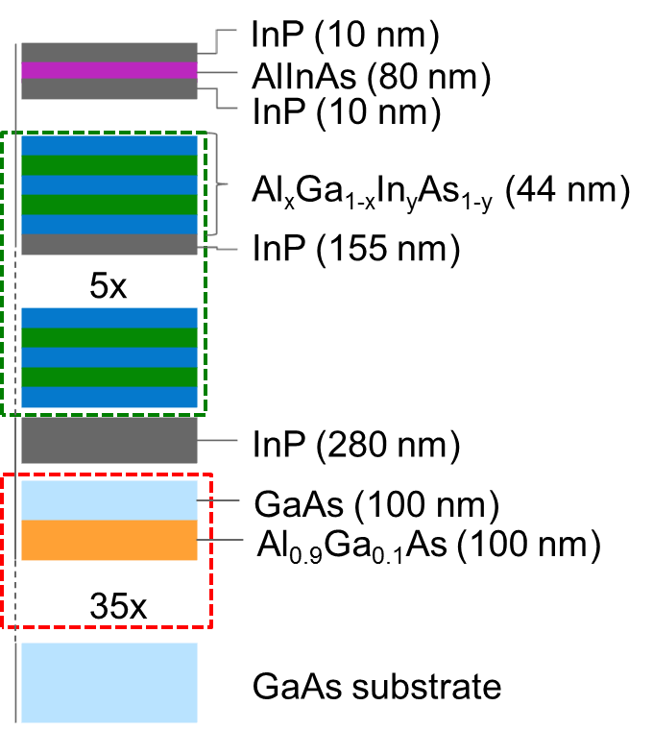
AFM-SIMS data acquisition
²⁷Al⁺
⁶⁹Ga⁺
¹¹⁵In⁺
AFM
MSM-XIX, 29 March -2 April 2014, Cambridge, UK

Slide 14
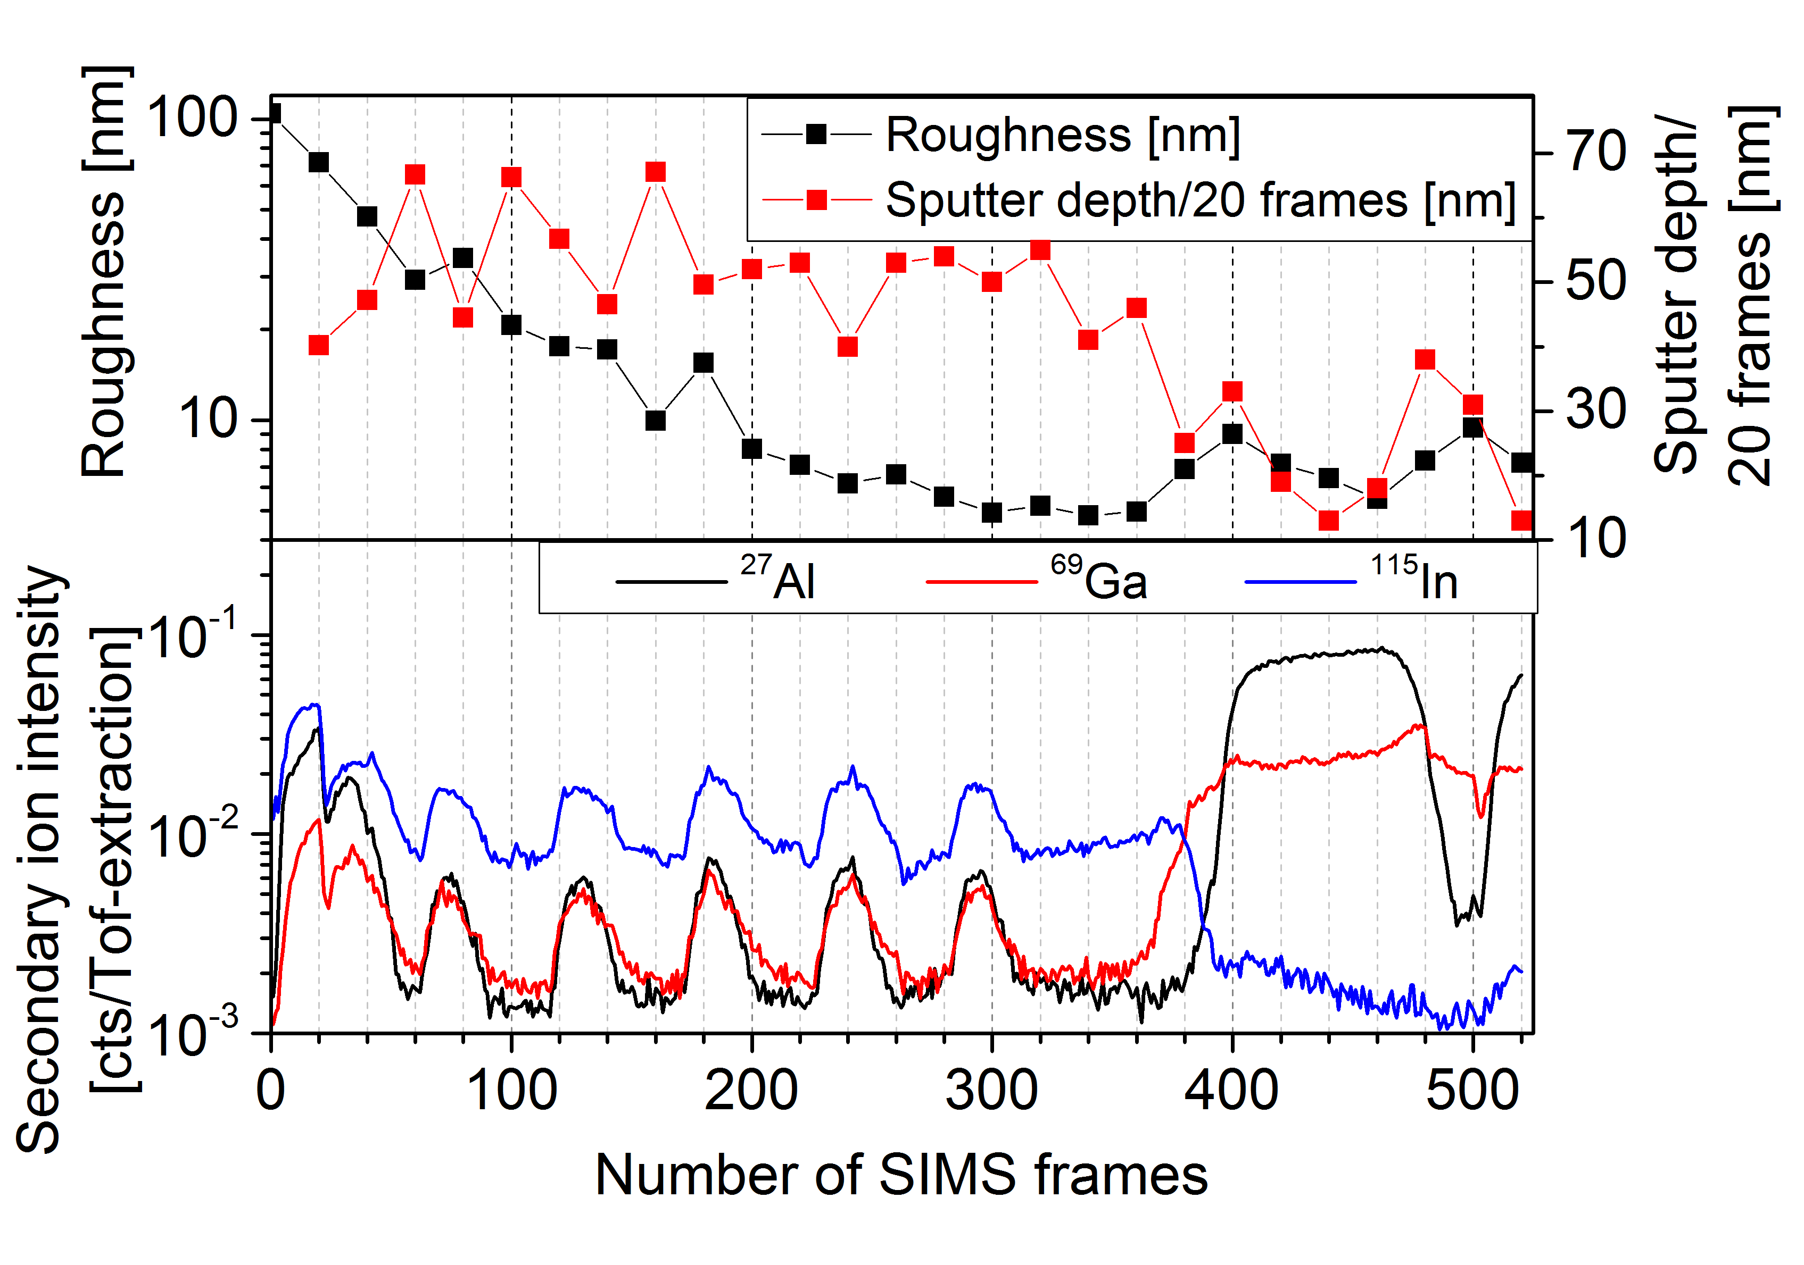
SEM data acquisition
Secondary electron image generated by Ga⁺ incident ions
Variation of the surface roughness during Ga⁺ bombardment
“Bubble formation”
MSM-XIX, 29 March -2 April 2014, Cambridge, UK

Slide 15
Cluster software
Cluster representation SIMS data from the VCSEL sample:
Represented clusters
Mass spectra of selected cluster
Collection of SIMS spectra of different voxels
Clustering voxels with similar mass spectra
- 3D Color encoded representation of the Voxel having a similar mass spectra
MSM-XIX, 29 March -2 April 2014, Cambridge, UK
Notes:
Check Dan Graham

Slide 16
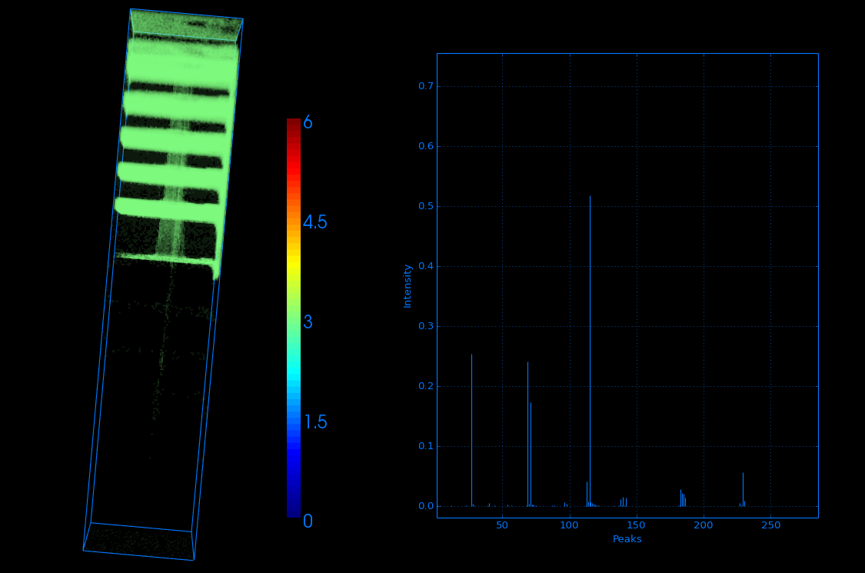
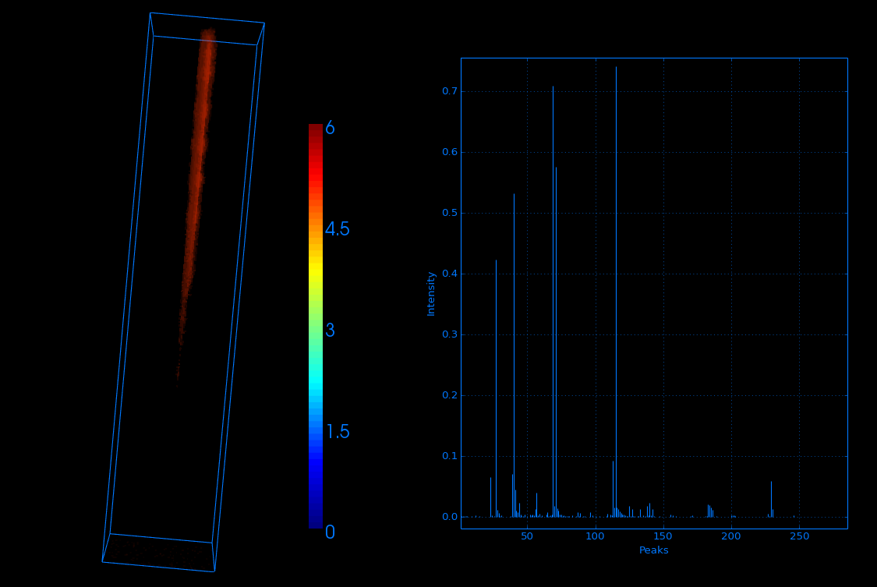
Cluster software
Color representation of layers rich in In
and Al
Dirt particle implanted from the surface
Easy to collect and combine interesting data.
Data interpretation is simplified, especially for Non-SIMS experts
MSM-XIX, 29 March -2 April 2014, Cambridge, UK

Slide 17
Conclusions
Automation of AFM-SIMS alternations is working
Opens up the possibility for SIMS depth and roughness correction
Long analysis run (over night analysis is possible)

Slide 18
Outlook
Implementing the AFM depth information in the Cluster software
Combining the AFM-SIMS data acquisition with other analysis techniques
- Application development
MSM-XIX, 29 March -2 April 2014, Cambridge, UK

Slide 19
Acknowledgment
James Whitby
Leandro von Werra
Johann Michler
Frederik Oestlund
Tobias Spetzler
The project UnivSEM received funding from the European Union Seventh Framework Programme (FP7/2007-2013) under grant agreement n° 280566
MSM-XIX, 29 March -2 April 2014, Cambridge, UK

